Slide 1




A1: Needfinding
Bryant Perkins

Slide 2
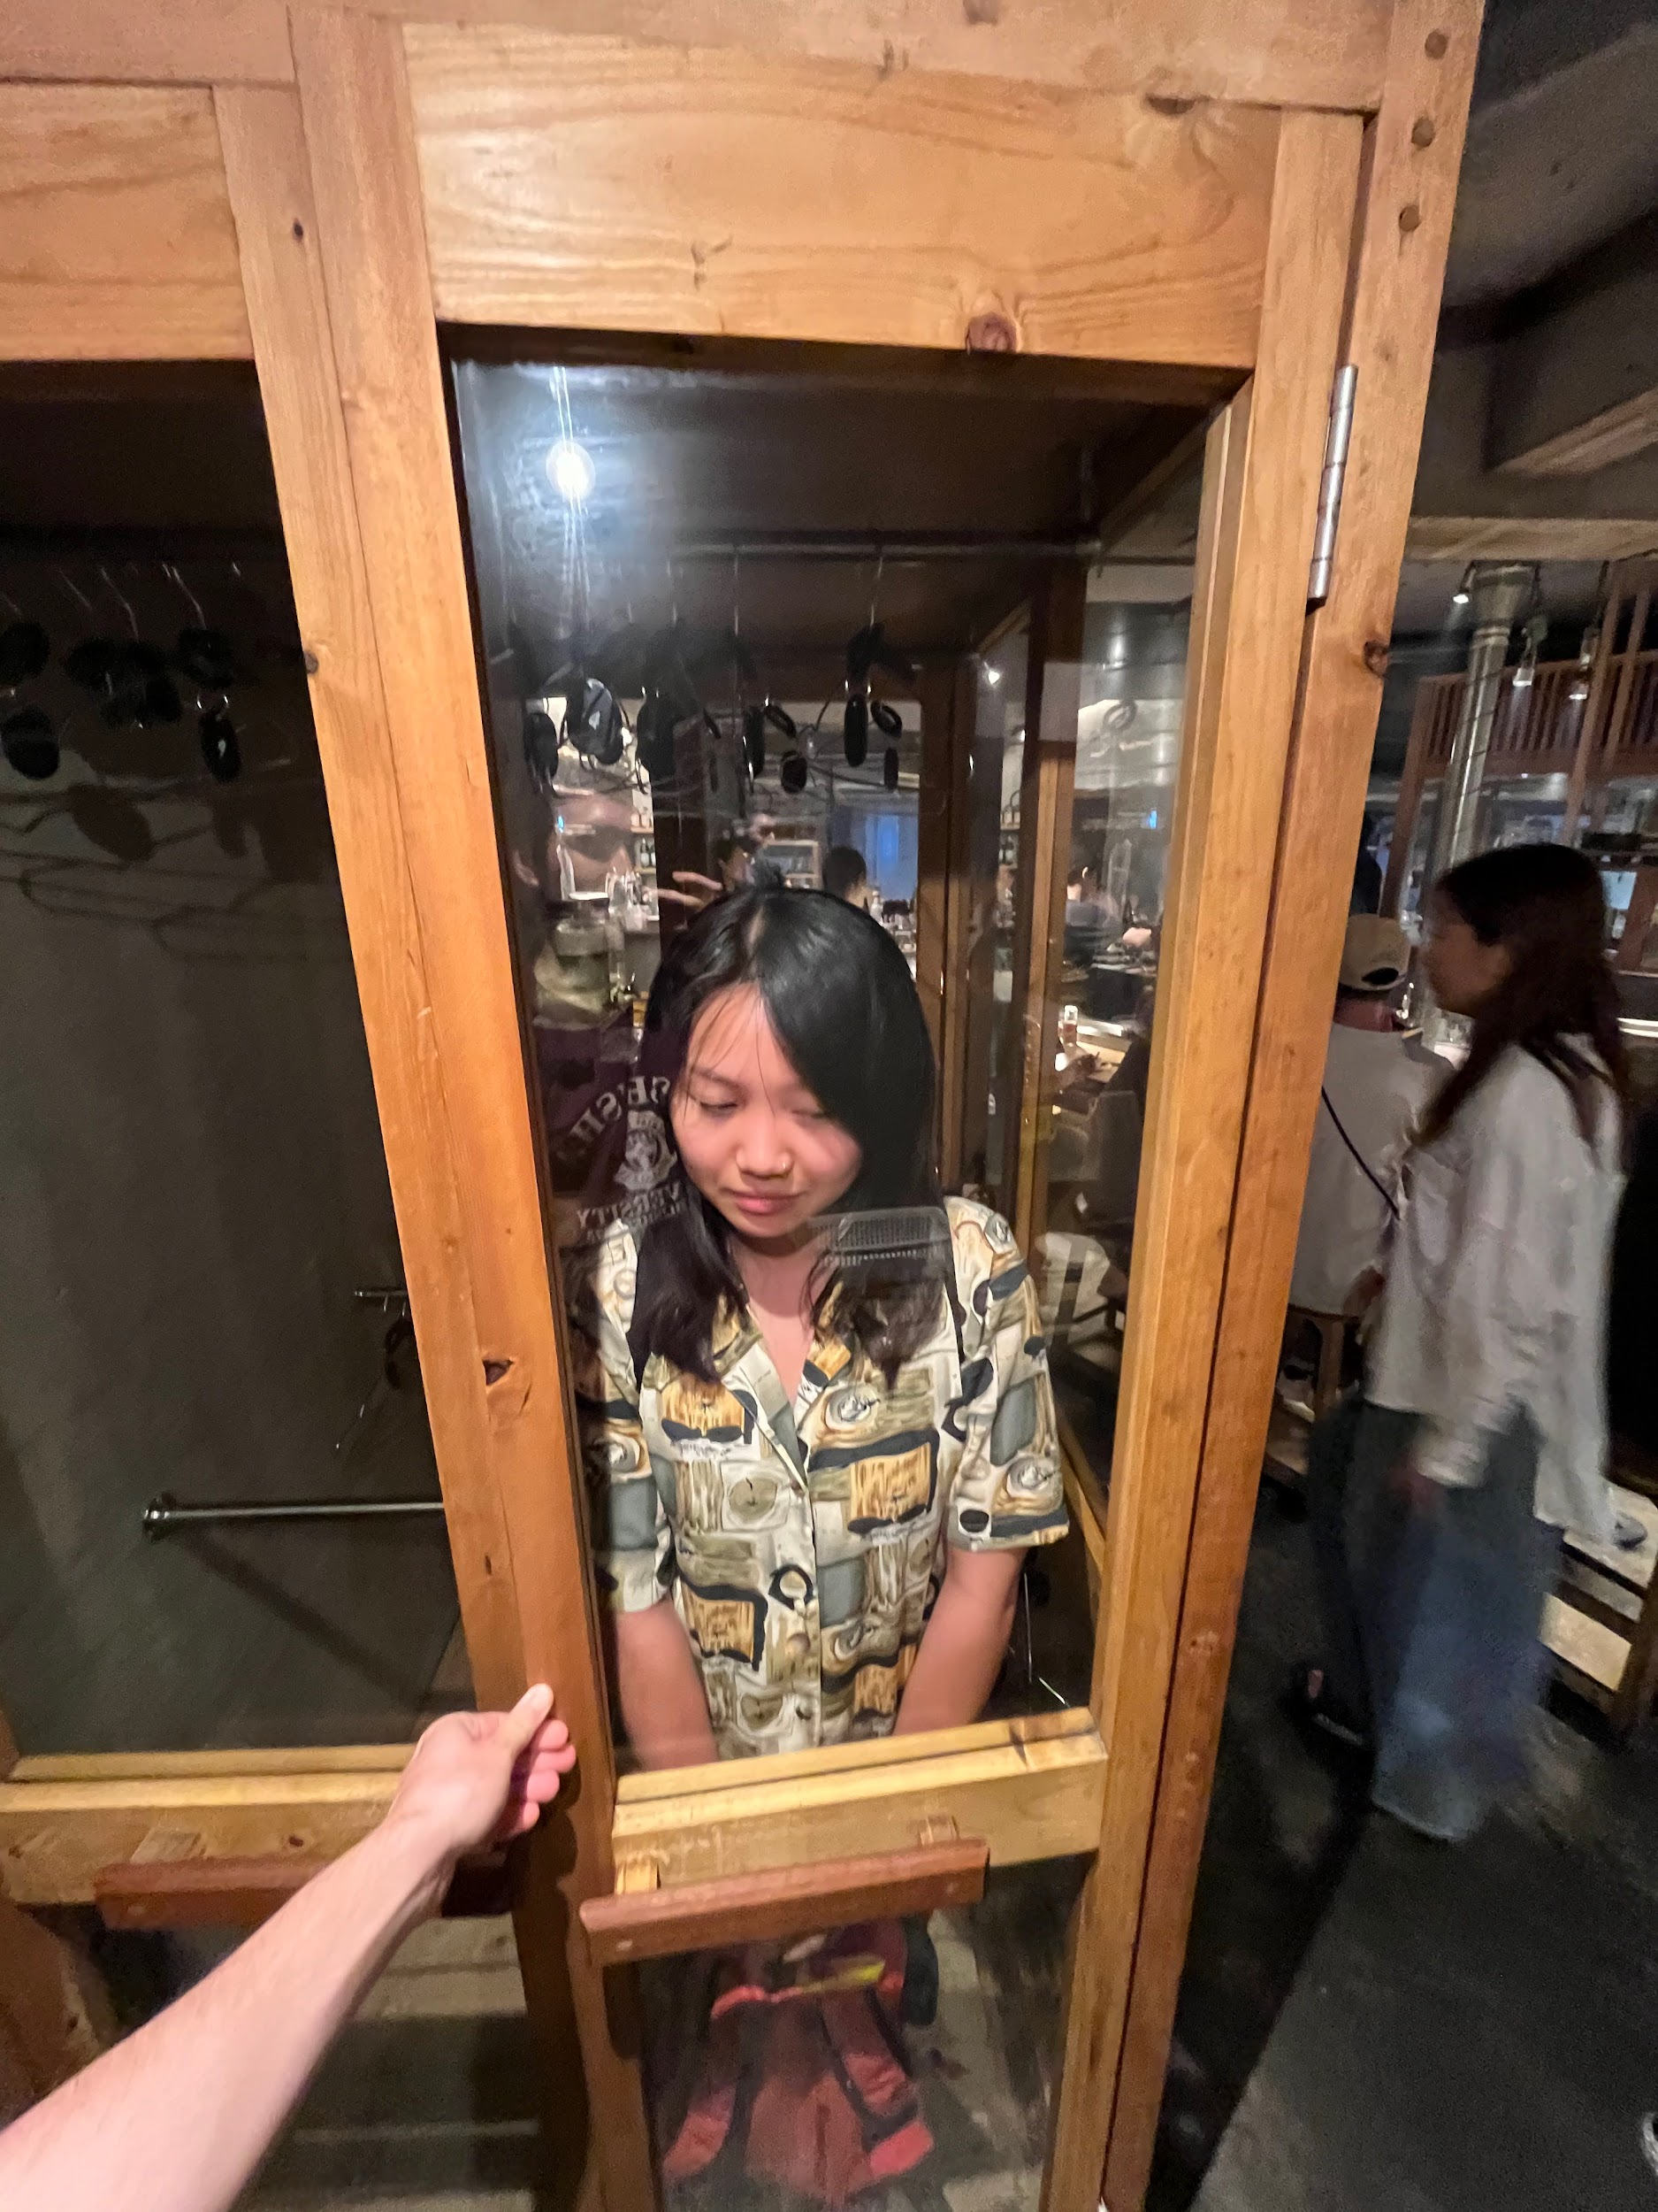

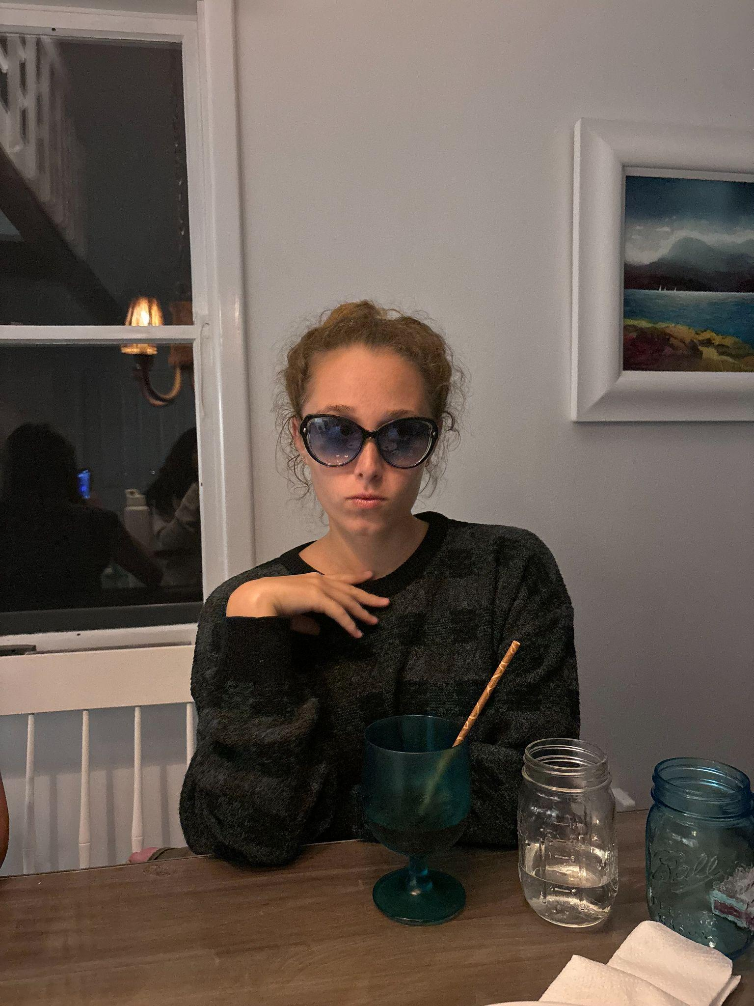
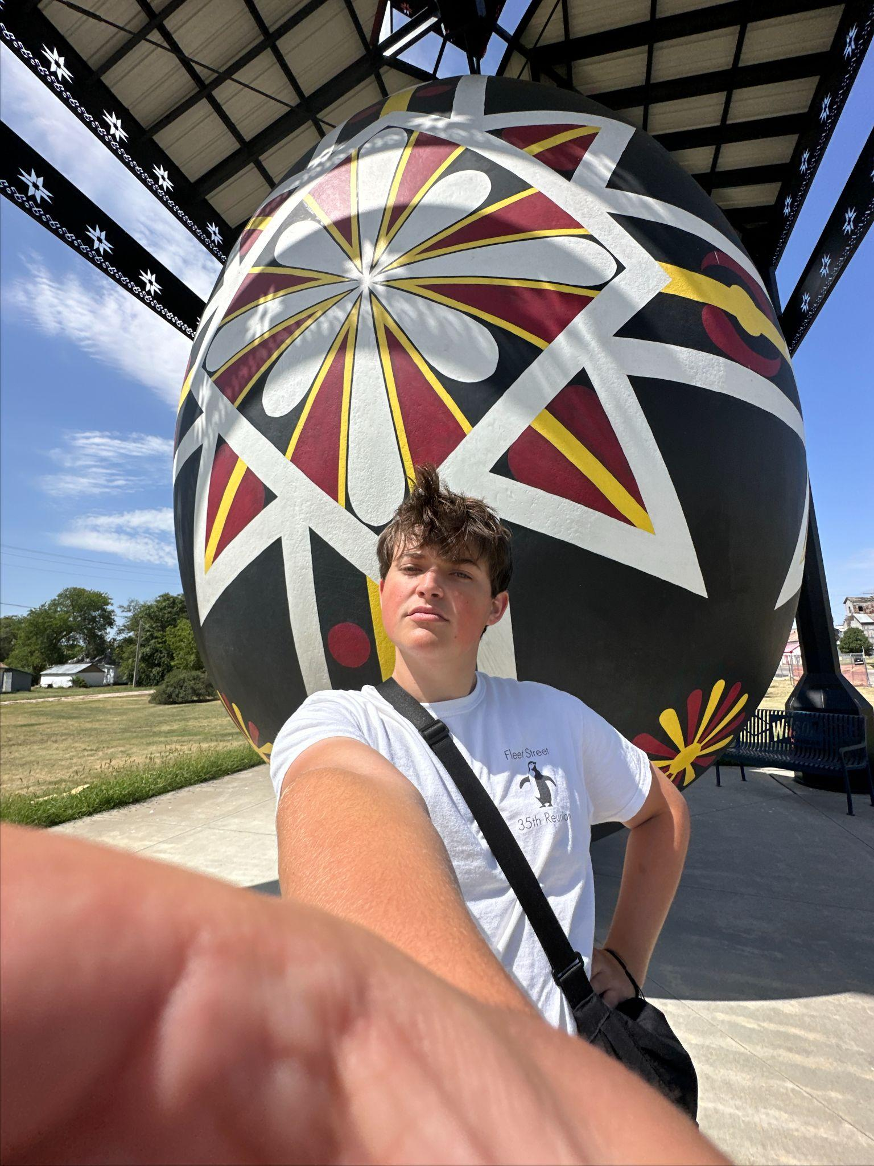



TEAM LImitless
Candy
Bryant
Lulu
Tommy
Domain: Language Learning 🤷‍♀️

Slide 3



Needfinding
Methodology

Slide 4
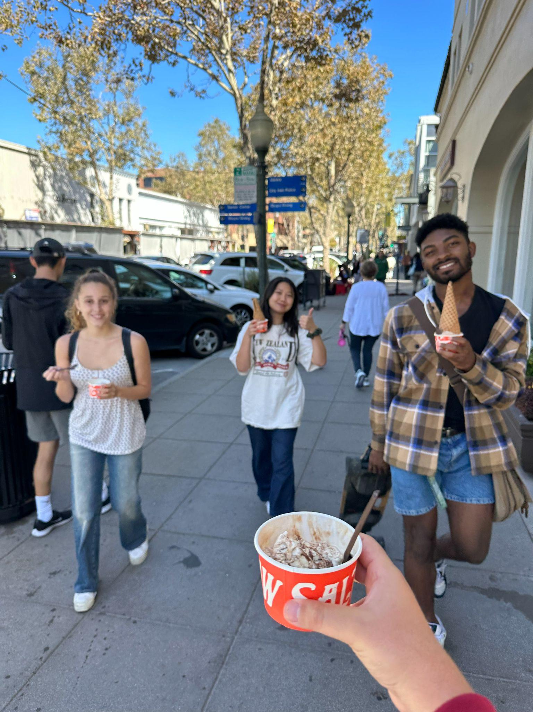
Participants
Who
4 random / 3 strategically selected
Linguistics Professor
Rabbi
Tourist
Stanford Student
Information compensation
Where
1 Park, 3 Coffee shops,
2 private offices, 1 Main Quad

Slide 5
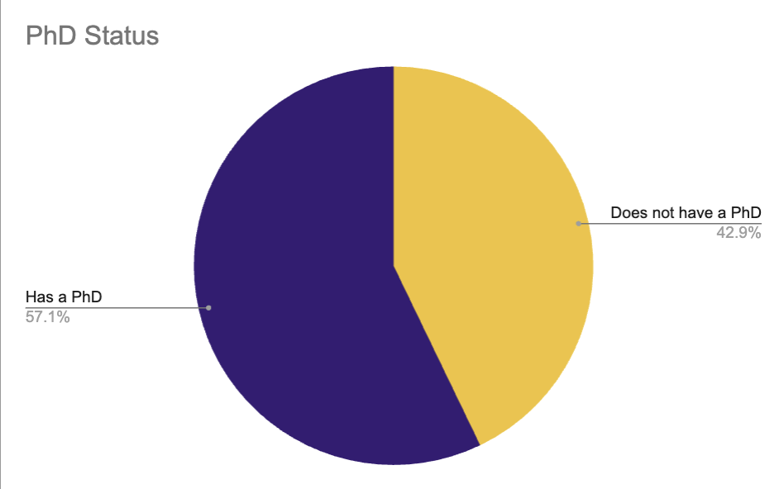
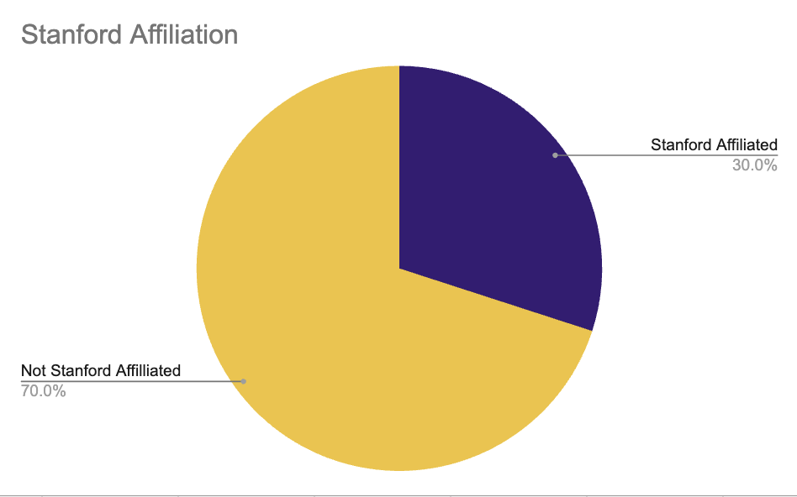
Stats and Trends
Extreme users:
Rebecca → particularly bad | Anna → luddite
Jennifer → experienced

Slide 6

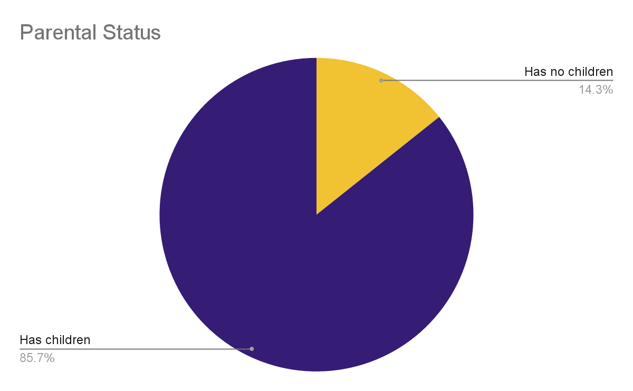
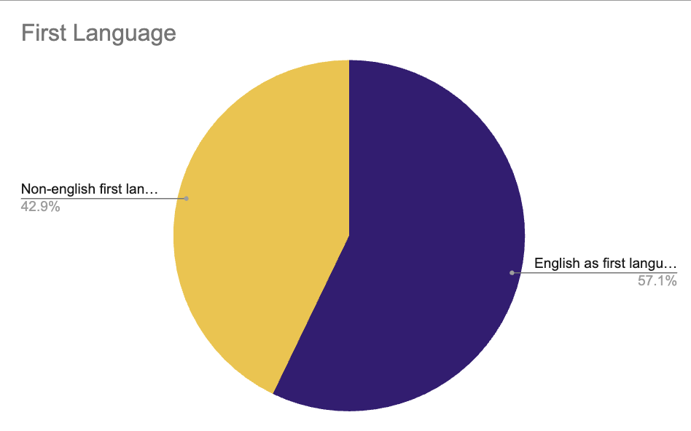
Stats and Trends
Extreme users:
Rebecca → particularly bad | Anna → luddite
Jennifer → experienced

Slide 7
Content & Roles
What was asked?
Language use: What/When/How (many)
Parents: How do you speak to/teach them
AI: yeah or no?
History and Cultural significance
Language exchange exercise
etc.
Roles
Switched up roles a lot

Slide 8
apparatuses
Recording
Apple’s voice memo → Otter.ai
Note taking
Google Docs
Notability
Notes App

Slide 9


Artifacts and Quotes
“OH GOD THIS IS SO AWFUL PLEASE JUST MAKE IT STOP”
“wait - are you doing a project with ai? 🤨”

Slide 10

Analysis

Slide 11
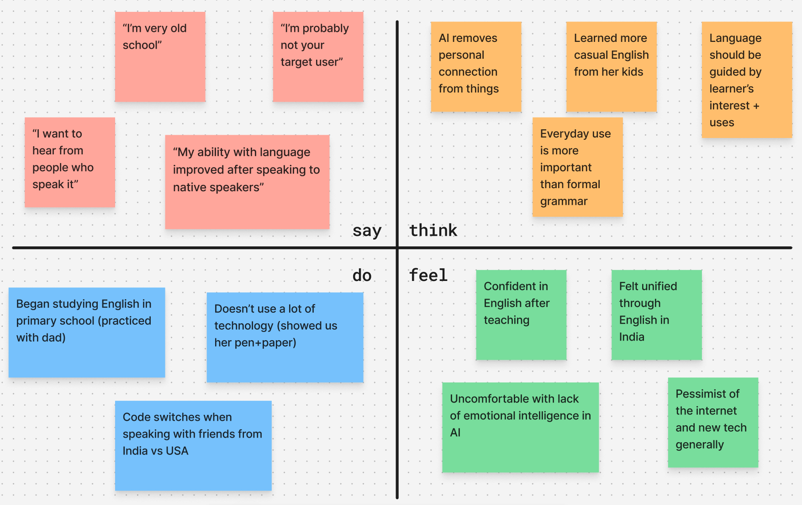
Anna
Surprises, tensions, and contradictions:
Contradiction: Grew up with academic focus but gravitates towards non-academic learning styles
Surprised: Was embarrassed to share new english slang from kids
Tension: Super critical of AI (“I am not unsettled, I am critical”)

Slide 12
Anna
Needs/insights:
Need to preserve emotional intelligence in teaching
Needs tailored language learning style, not one size fits all
Insight: Users may be deeply uncomfortable with AI
Insight: Some want to hold on to traditional learning styles
Insight: Teaching is also a great method for learning

Slide 13
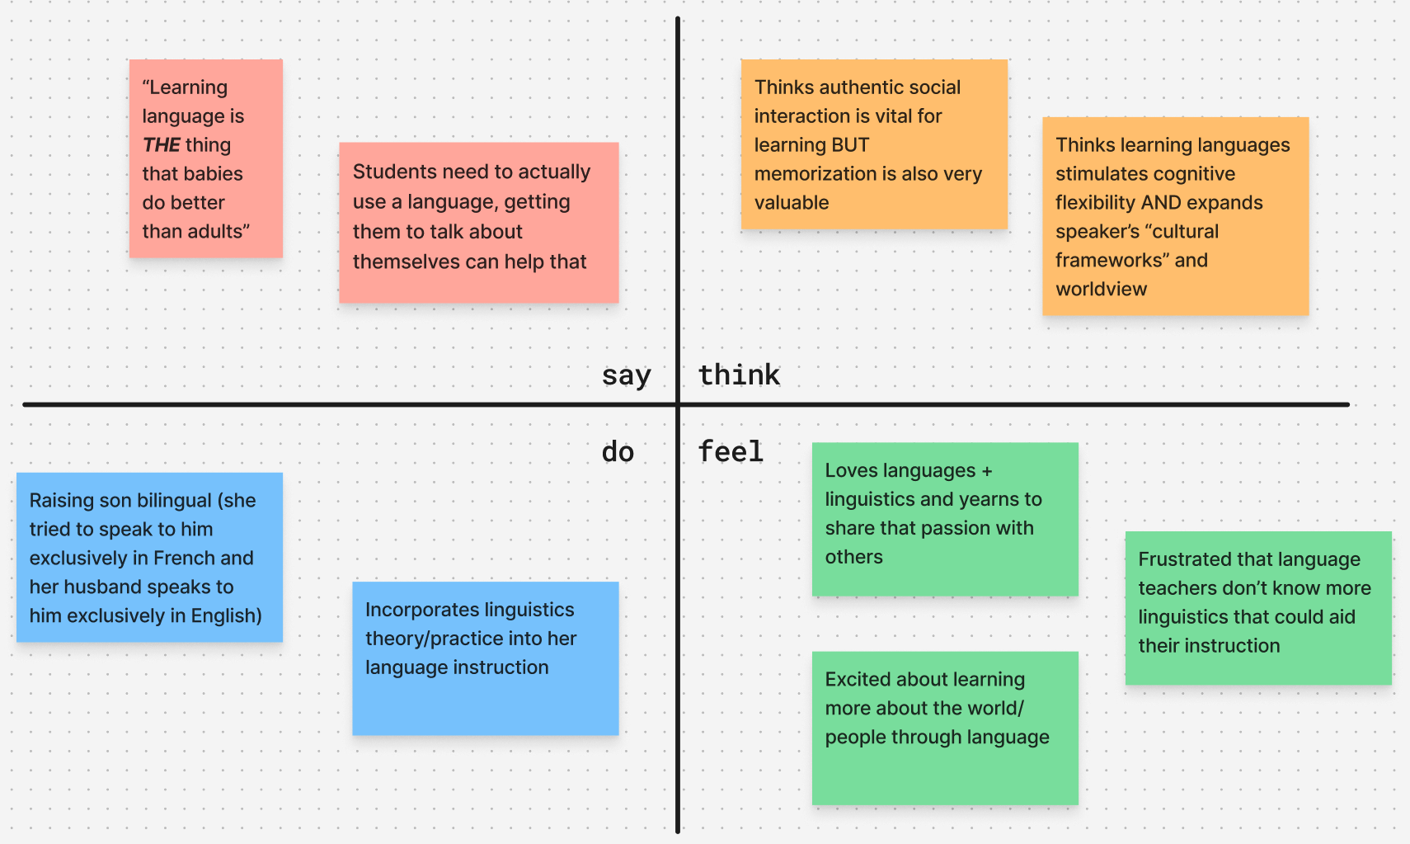
Jennifer
Surprises, tensions, and contradictions:
Tension: has had positive experiences incorporating linguistics into language teaching, but worries whether too much technicality would go over language teachers’ and learners’ heads
Tension: believes that authentic social interaction is vital, and recognizes rote memorization as valuable

Slide 14
Jennifer
Needs and insights:
Jennifer needs an aid for teaching language which balances social interaction and rote memorization
Insight: A potential limitation of current apps is their inability to simulate authentic conversation
Insight: Learning a language may be good for you — might expand your worldview and your cognitive flexibility
Jennifer needs a language learning medium that centers the culture and people which that language belongs to

Slide 15
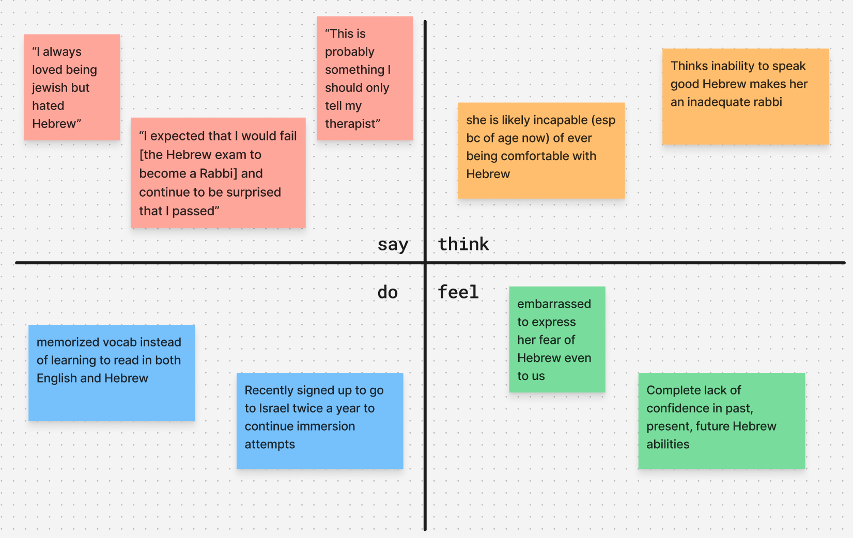
Rebecca
Surprises/tensions/contradictions:
Surprised that she has so little confidence that she literally doesn’t believe she passed the Hebrew exam
Tension: cutting herself off when talking about particularly how she still feels like she will never learn and saying she should save for therapist
Fear/embarrassment held her back from doing things she knew would help like immersion in study abroad
Contradiction: Thinks she will never really learn at this point but still signed up for Israel immersion now

Slide 16
Rebecca
Needs/insights:
Needs to gain confidence in language learning
Needs a new way to learn a language
Insight: Language learning is more difficult for people with learning disabilities
Insight: Language learning is more difficult the longer you struggle at it

Slide 17

Key Learnings
Little diversity in interviews
There’s is a negative connotation with AI
Language Learning applications have much to be improved on

Slide 18
What’s Next?
More interviews with a younger audience
Less of higher education
Thoughts on AI/other language technologies
Heritage learners/Those with no formal instruction in second language

Slide 19





Appendix

Slide 20
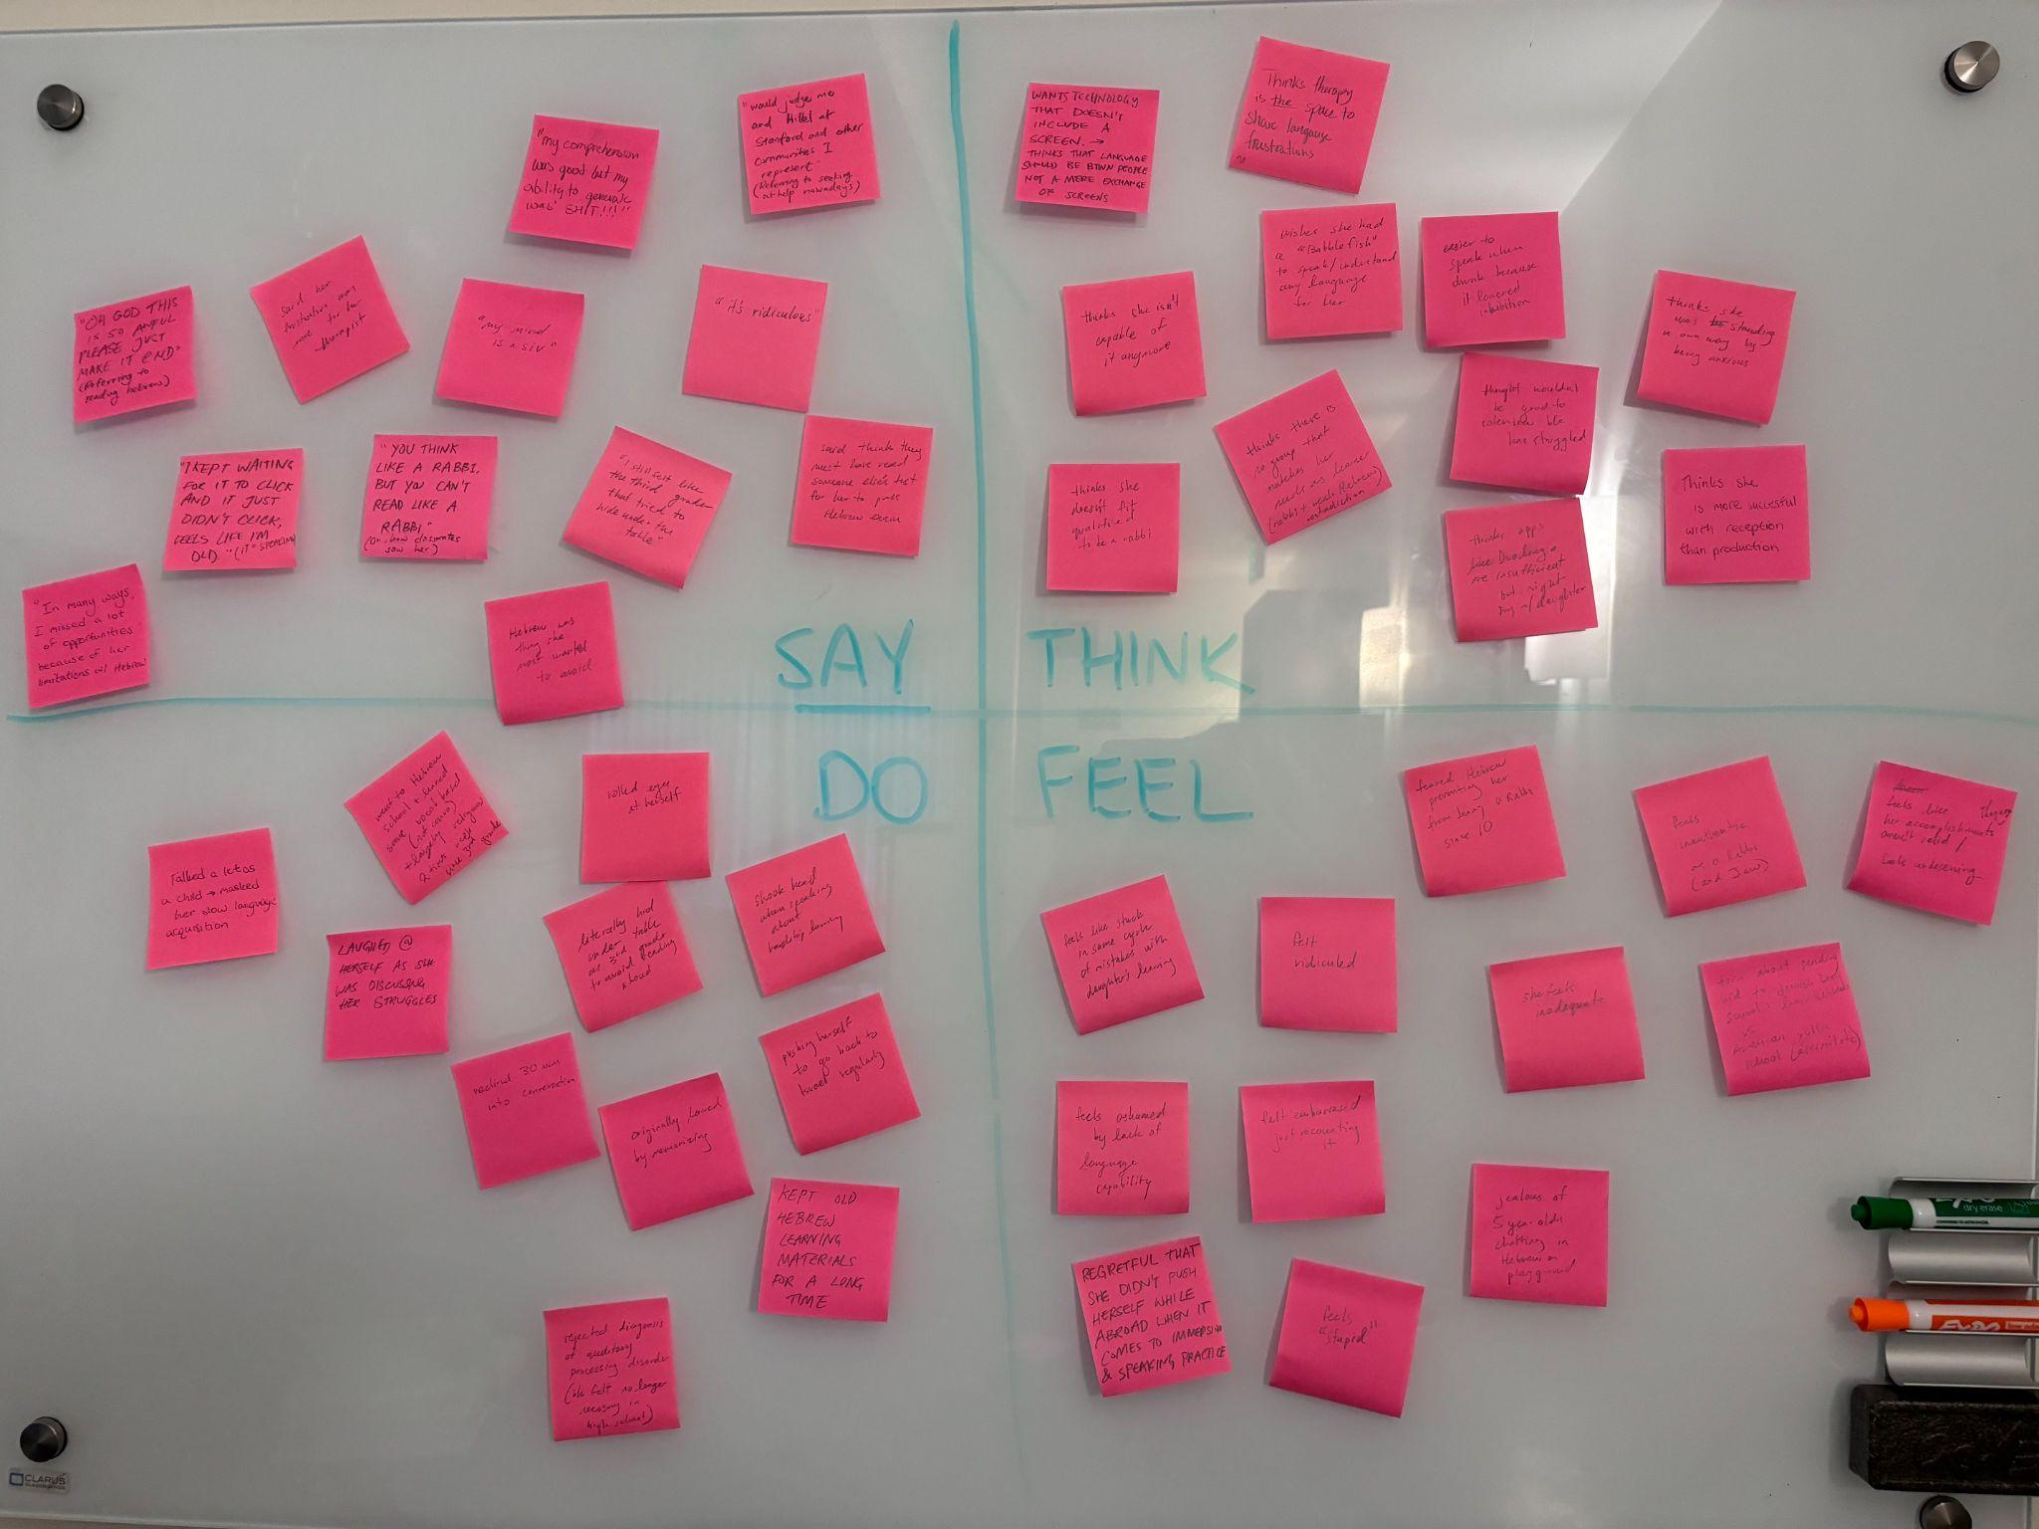
Rebecca
(zoomed in quadrants in google folder)

Slide 21
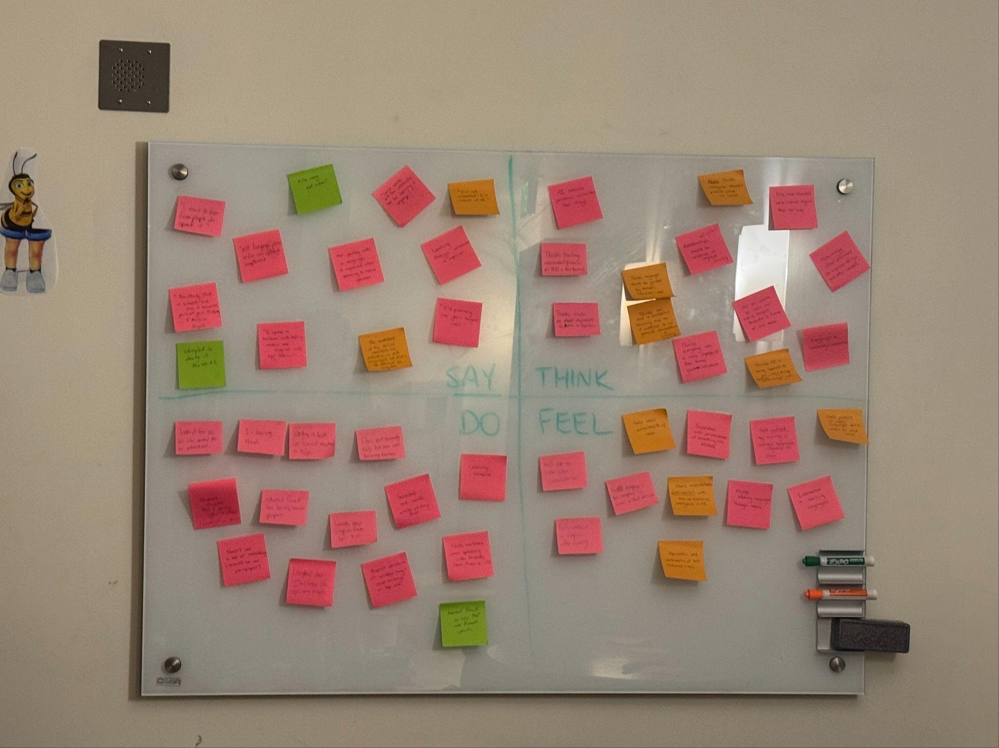
Anna
(zoomed in quadrants in google folder)

Slide 22
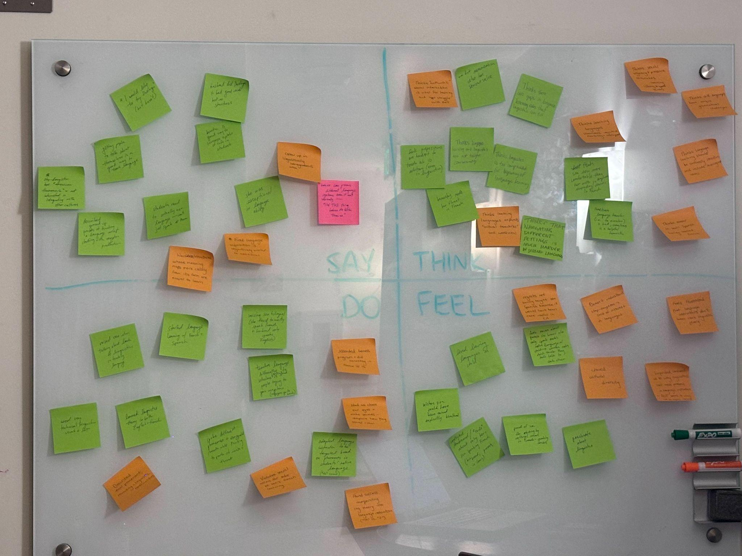
Jennifer
(zoomed in quadrants in google folder)

Slide 23
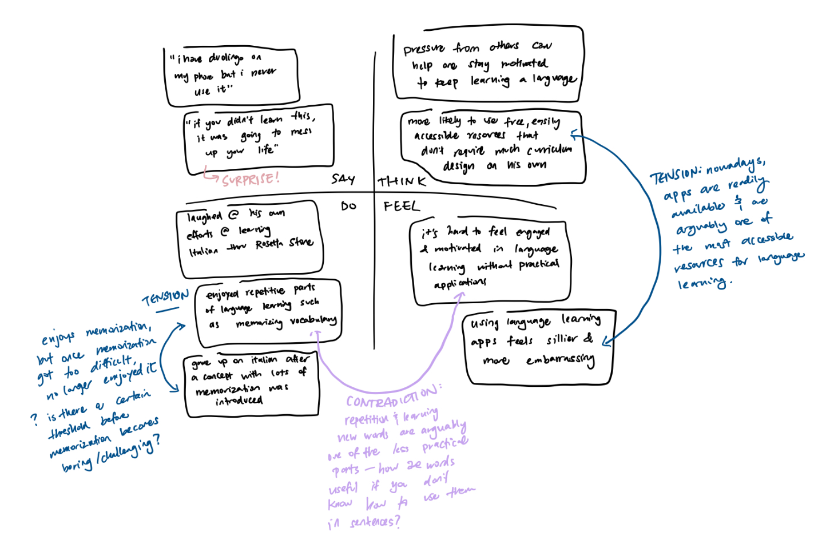
Steve
_{Needs & Insights:}
Needs a way to learn a language that’s organized, free/low-cost, and practical.
Needs learning curves in language learning journeys to be gradual, yet challenging enough to remain engaging.
Views a lot of digital language learning resources (eg: Duolingo, Rosetta Stone) as impractical.

Slide 24
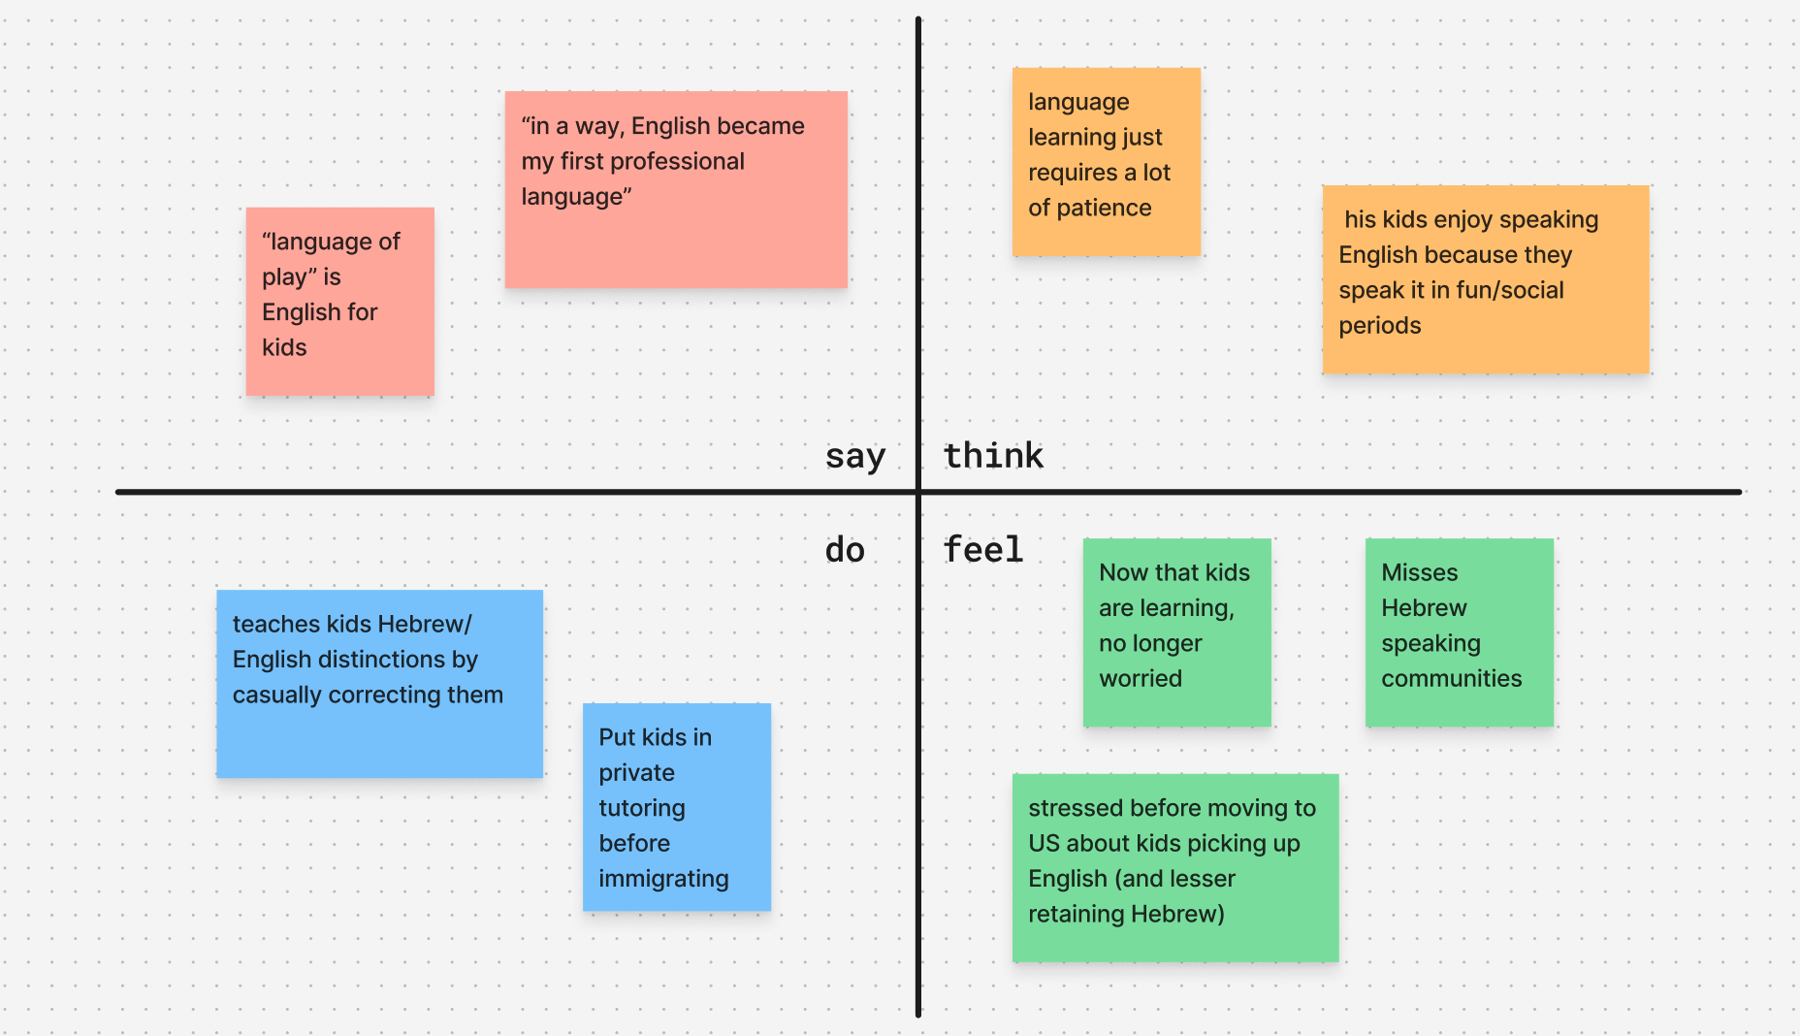
David
Surprises/tensions/contradictions:
Was really anxious about kids English acquisition but now seems really chill and even laughing at past anxiety
English as a professional language for him vs play for his kids
Needs/insights:
He needs a way to feel more confident that him and his kids will learn and retain Hebrew
It isn’t obvious when immigrating how good language assimilation opportunities will be
Language acquisition can be fun in a natural way

Slide 25
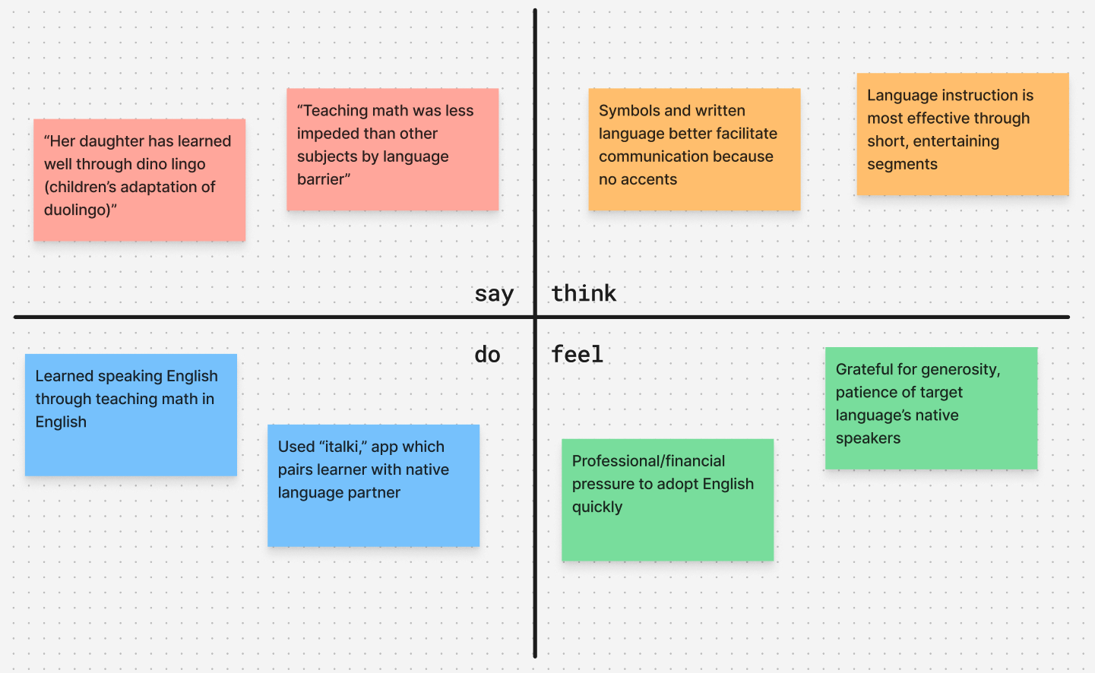
Lola
Surprises/tensions/contradictions
Contradiction: believes written language is more objective and interpretable, but has used conversation primarily for her intentional language learning/practice
Surprise: because of strong immigrant community post-immigration felt more professional pressure than social pressure to learn english
Needs/insights:
Lola needs a language learning tool that involves visual stimulation
Insight: People learn well by talking to native speakers of a language

Slide 26
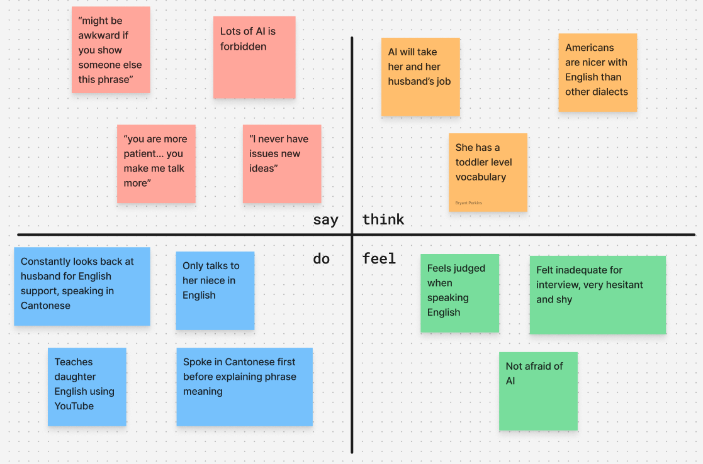
Hannah
Surprises/tensions/contradictions
Says she has toddler level vocab but also doesn’t ever have issues creating new ideas
English speakers outside of the US are intimidating and limit her speaking performance
A lot of AI is forbidden but she thinks it will take her job
Is not trying to learn more English
Needs/insights:
A more comprehensive diagnostic with informative results could be useful for properly attaining confidence
People need nicer and patient speaking partners

Slide 27

thanks!!!

